Slide 1
Types of Forces

Slide 2
Applied Forces
Originate from an object touching another object
The force is applied through where the objects touch
These are typically pushing forces
Applied forces can pull if a rope is attached

Slide 3
Gravity
All objects at or near the surface of the earth experience a pulling force from the earth
This is what holds objects to the ground
Gravity ALWAYS acts downwards (towards the surface of the earth)

Slide 4
A Useful Tool…
A plumb-bob is a mass tied to a string
The force of gravity pulls the mass downwards, which causes the string to be pulled downwards
This creates a perfectly vertical line
This is very useful if you want two objects to be vertically aligned

Slide 5
How This Is Important To Me

Slide 6
Normal Force
These forces are applied by a large surface onto an object
This force is ALWAYS perpendicular to the surface
This is why it is called normal force (normal means perpendicular)
Normal forces press the surfaces together

Slide 7
Frictional Forces
ALWAYS act to reduce or prevent the relative motion of two surfaces in contact
Frictional forces ALWAYS act parallel to the surfaces

Slide 8
Why does Friction Occur
All surfaces no matter how smooth they appear are uneven with peaks and valleys
When two surfaces are placed together, the peaks on one surface fall in the valleys on the other
This causes the surfaces to interlock

Slide 9
Why Friction Occurs
For one surface to move past the other:
The peaks on each surface must climb (be lifted) out of the valleys on the other surface
The peaks must break through the peaks in the way
This creates resistance for the surfaces to move by
Thus, frictional forces will ALWAYS oppose the motion or desired motion between two surfaces

Slide 10
Types of Friction
Two Types
Static (when the surfaces are not moving past each other)
Kinetic (when the surfaces are moving past each other)

Slide 11
Static Friction
Occur when the surfaces are not moving
Attempts to keep the surfaces from moving

Slide 12
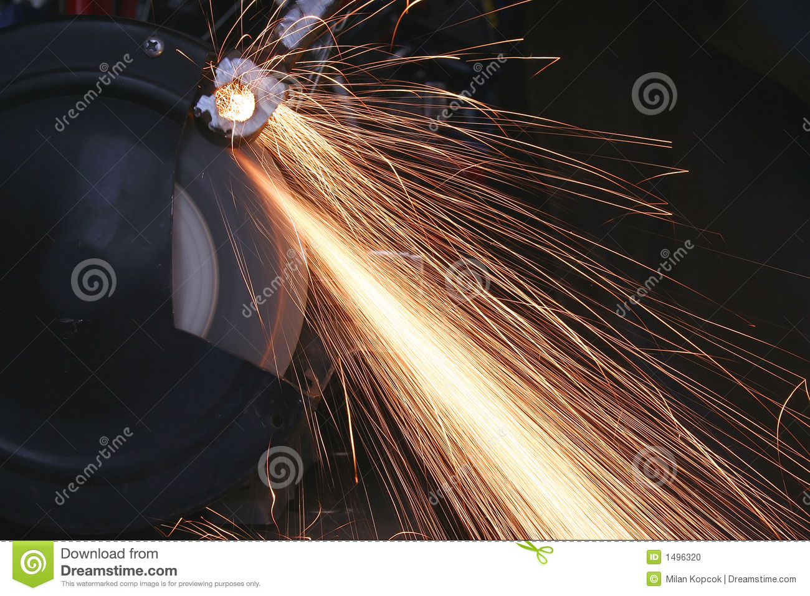
Kinetic Friction
Occurs when the surfaces are moving
Kinetic friction tries to slow down the motion between surfaces
Exerts a force in the opposite direction of the motion between surfaces
This causes the BOTH surfaces to wear
The harder a surface is the less it will wear
Kinetic friction can also produce heat and light
https://www.dreamstime.com/stock-photo-bench-grinder-image1496320

Slide 13
Activity
With your neighbors, make a list of situations where you want each type of friction and where you do not want each type of friction
 | Static Friction | Kinetic friction
Want
Don’t want

Slide 14
Force
Is measured in Newtons
We use “N” as the unit for Newtons

Slide 15
Multiple Forces Acting on an Object
When multiple forces act on an object, we need to find the net force or resultant force

